Slide 1

Customer Shopping Behavior Analysis
This project analyzes customer shopping behavior using transactional data to uncover key insights for strategic business decisions.

Slide 2

Project Overview
Uncovering Key Insights from Purchase Data
This analysis delves into customer shopping behavior, leveraging transactional data from 3,900 purchases across diverse product categories. Our primary objective is to extract actionable insights into:
Spending patterns
Customer segmentation
Product preferences
Subscription behavior
These insights will inform strategic business decisions, optimize marketing efforts, and enhance the overall customer experience.

Slide 3
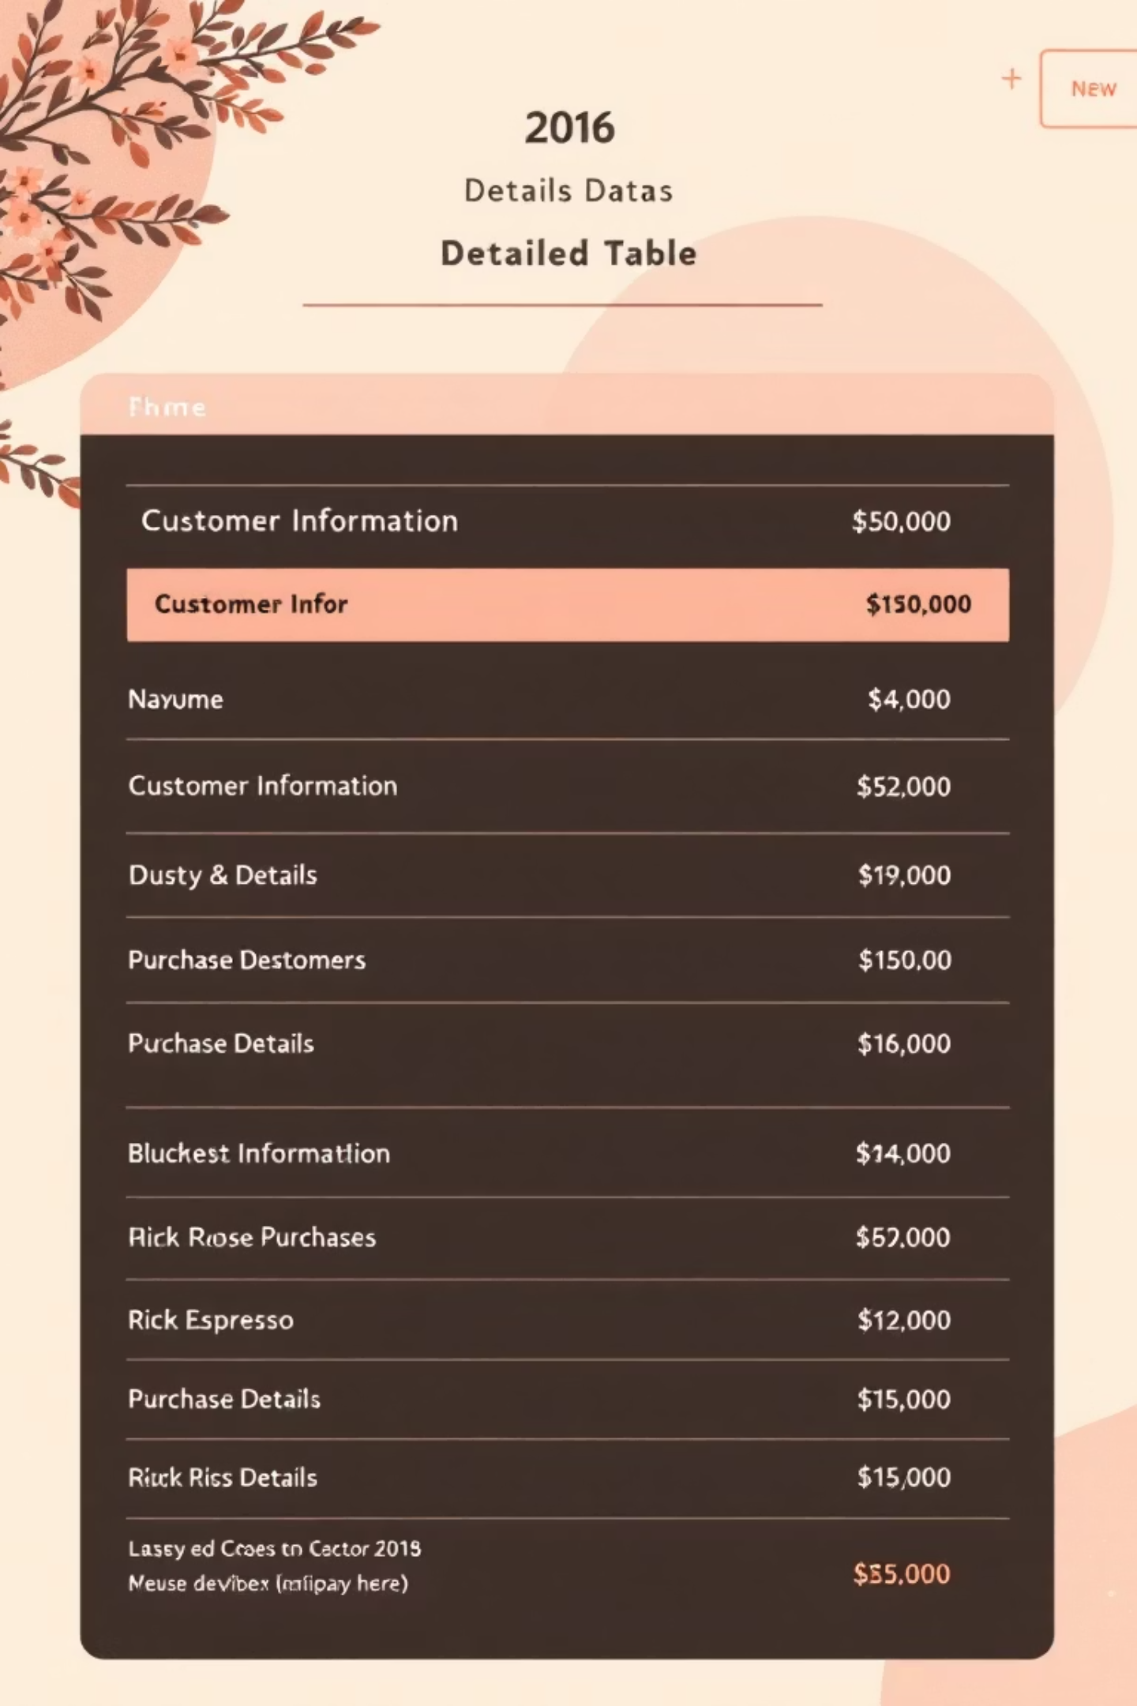
Dataset Overview
A Comprehensive Look at Our Transactional Data
1
2
Dataset Size
Key Features
3,900 Rows, 18 Columns
Demographics, Purchase Details, Shopping Behavior
3
Missing Data
37 values in "Review Rating" column
Our dataset provides a rich foundation for understanding customer interactions, covering everything from basic demographics to detailed purchase and behavioral patterns.

Slide 4
Exploratory Data Analysis
Python-Powered Data Preparation & Cleaning
01
02
03
Data Loading & Initial Exploration
Missing Data Handling
Column Standardization
Imputed 37 missing "Review Rating" values using the median rating per product category.
Renamed columns to snake_case for improved readability and documentation standards.
Imported dataset using pandas; used df.info() and .describe() for structural and summary insights.
04
05
Feature Engineering
Data Consistency & Integration
Created age_group (binned ages) and purchase_frequency_days for deeper analysis.
Verified and dropped redundant promo_code_used column. Loaded cleaned data into MySQL for further analysis.

Slide 5
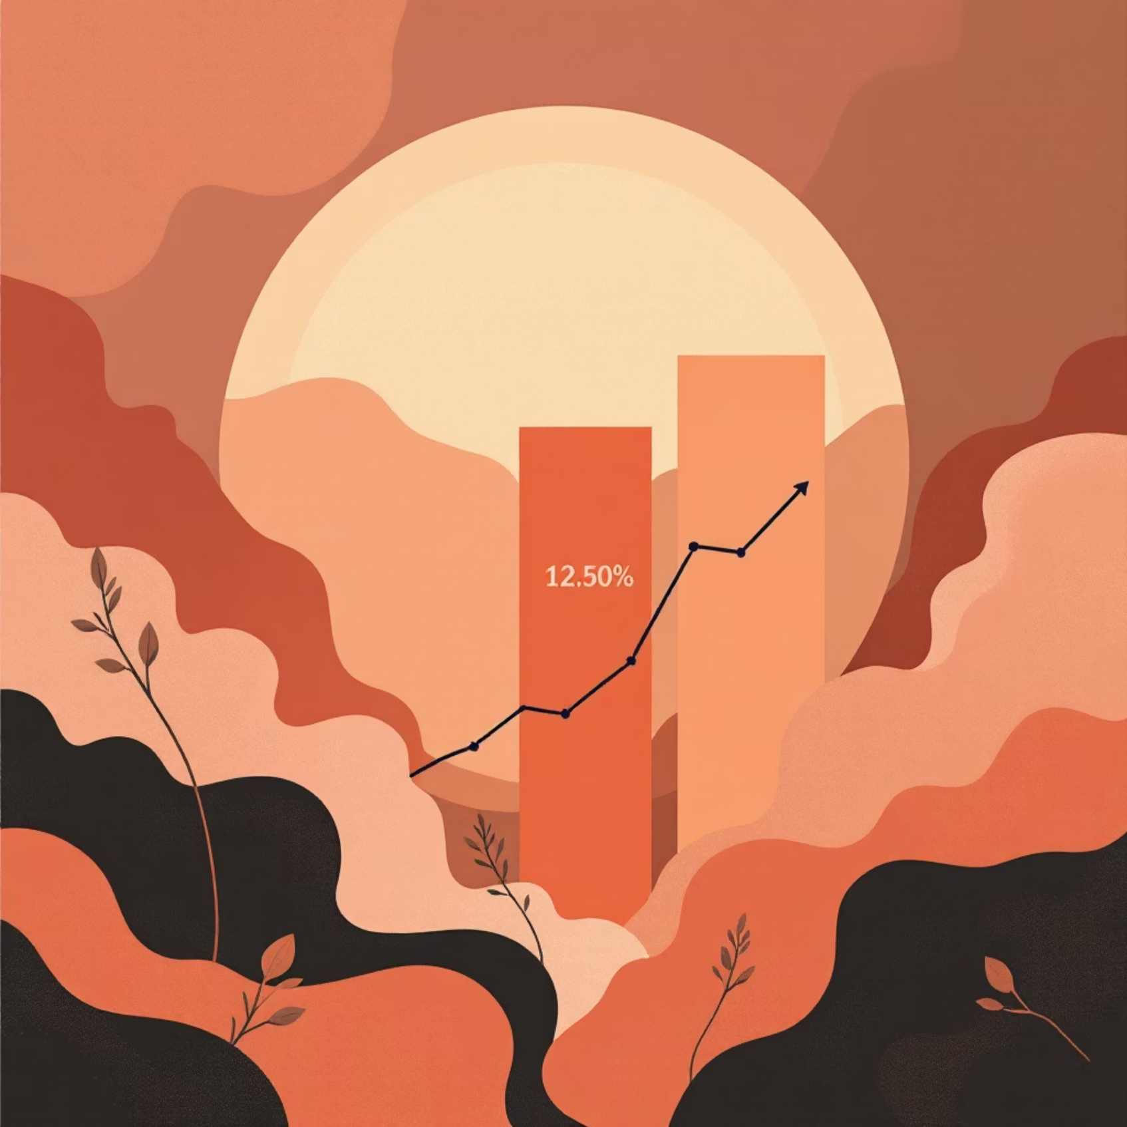
SQL Data Analysis - Key Business Questions
Gender & Spending: Revenue Insights
Our SQL analysis began by comparing total revenue generated by male versus female customers. This provides a foundational understanding of which gender segment contributes more significantly to overall sales.
Female
75191
Male
157890
Male customers generated $157,890 in revenue, significantly outpacing female customers who generated $75,191.

Slide 6

SQL Data Analysis - Discounts & Top Products
High Spenders and Product Preferences
High-Spending Discount Users
Top 5 Products by Rating
We identified 839 customers who used discounts but still spent above the average purchase amount, indicating potential for increased loyalty or targeted upselling.
Customer reviews highlight product success. Gloves lead with a 3.86 average rating, followed closely by Sandals and Boots.
Gloves
3.86
Sandals
3.84
Boots
3.82
Hat
3.80
Skirt
3.78
These products are prime candidates for promotional campaigns.

Slide 7

SQL Data Analysis - Shipping & Subscriptions
Optimizing Delivery and Membership Strategies
Shipping Type Comparison
Subscribers vs. Non-Subscribers
Customers using Express shipping have a slightly higher average purchase amount ($60.48) compared to Standard shipping ($58.46). This suggests a willingness to spend more for faster delivery.
Yes
1053
59.49
62645.00
No
2847
59.87
170436.00
Non-subscribers contribute significantly more to total revenue, indicating a large untapped potential for subscription conversions.

Slide 8

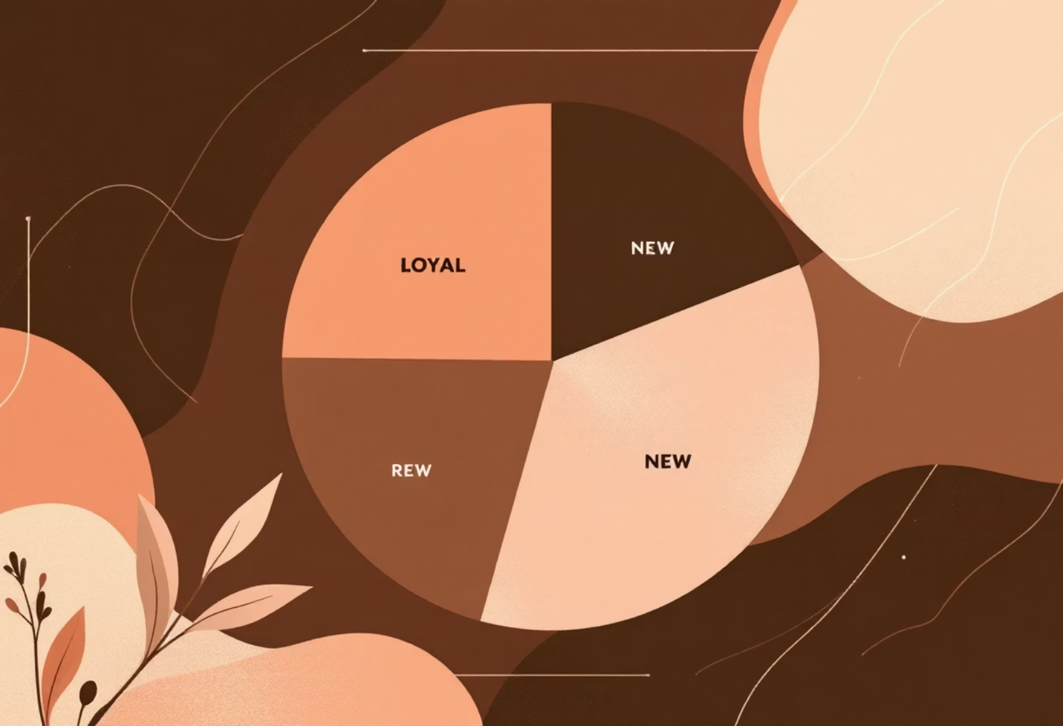
SQL Data Analysis - Products & Segmentation
Targeting and Loyalty
Discount-Dependent Products
Customer Segmentation
Hats (50%), Sneakers (49.66%), and Coats (49.07%) show the highest percentage of discounted purchases. This highlights their sensitivity to price promotions.
Our customer base is primarily Loyal (3,116), followed by Returning (701) and New (83). Tailored strategies can nurture each segment.

Slide 9

SQL Data Analysis - Age & Categories
Understanding Demographics and Preferences
Top 3 Products per Category
Revenue by Age Group
Identifying best-sellers within each category allows for focused inventory management and marketing.
Young Adults ($62,143) are the highest revenue contributors, followed by Middle-aged ($59,197) and Adults ($55,978). Seniors contribute $55,763.
Accessories: Jewelry, Sunglasses, Belt
Clothing: Blouse, Pants, Shirt
Young Adult
62143
Footwear: Sandals, Shoes, Sneakers
Outerwear: Jacket, Coat
Middle-aged
59197
Adult
55978
Senior
55763
This data informs age-specific marketing campaigns.

Slide 10

Business Recommendations
Actionable Strategies for Growth
Boost Subscriptions
Customer Loyalty Programs
Review Discount Policy
Promote exclusive benefits and content for subscribers to enhance value and conversion.
Strategically optimize discount offerings to balance sales boosts with healthy profit margins.
Implement tiered rewards to incentivize repeat purchases and elevate customers to the "Loyal" segment.
Product Positioning
Targeted Marketing
Highlight top-rated and best-selling products in marketing campaigns to leverage social proof and demand.
Focus marketing efforts on high-revenue age groups and customers who prefer express shipping.
These recommendations, derived from our comprehensive analysis, provide a clear roadmap for enhancing business performance.

